Slide 1
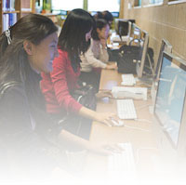
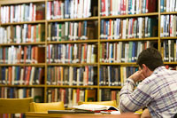
John Taggart Hinckley Library
“We must go to the library for the completion
of our humanity.”
~ paraphrased from Owen Meredith

Slide 2
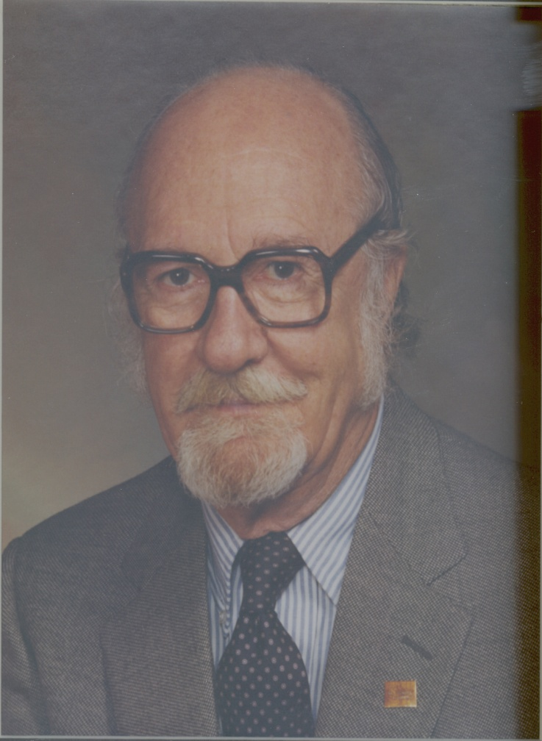
John Taggart Hinckley
In 1947, about a year after Northwest College offers classes at Powell High School, John Taggart Hinckley, professor of Political Science forms the first library collection, about 15 books. By 1949 the collection numbers 100 and Professor Hinckley speaks with Powell Public Library about shelf space.
Source: Hinckley Family

Slide 3
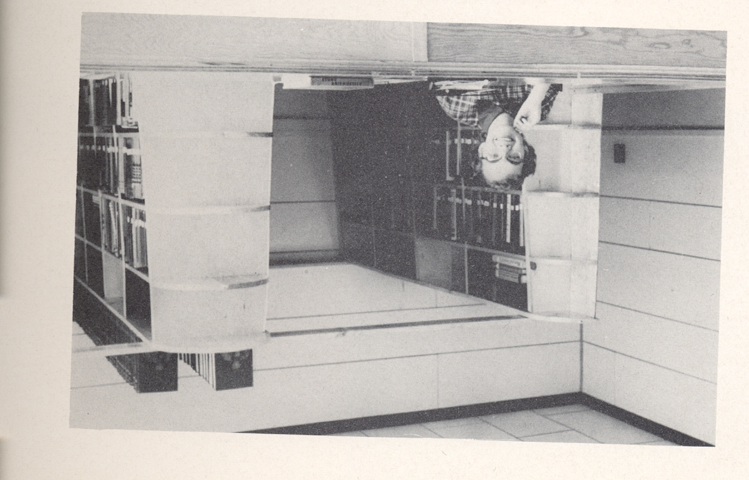
The White House
Fall 1949, the college moves classes into the “grade school bungalow” or “White House,” a remodeled barracks from Heart Mountain Relocation Center located on the high school campus. In 1952, the library moves into its own room. The room includes shelving and study tables.
Sandra Tolman, Library staff, 1952,
source: NWC “The Lion” yearbook, 1952

Slide 4
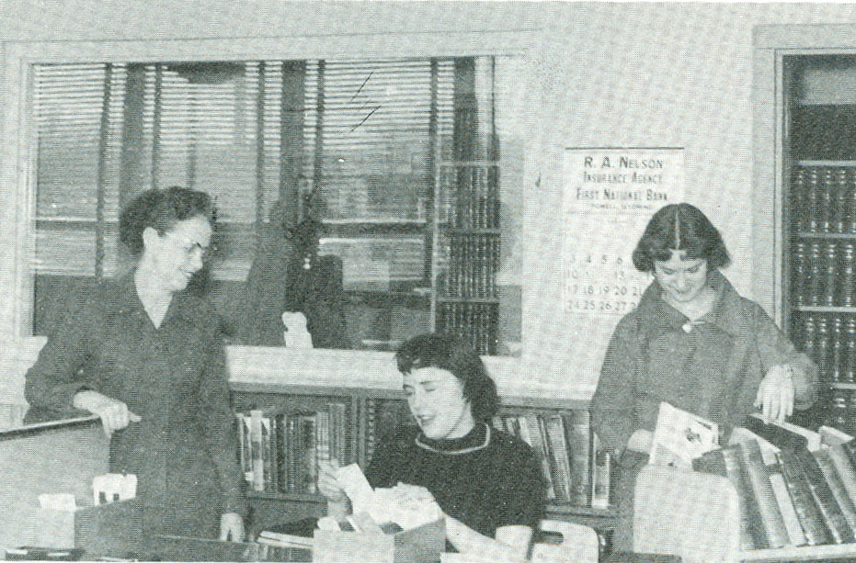
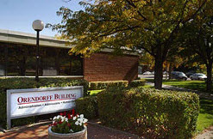
Orendorff Building “Library”
In 1954, the college constructs the Orendorff Building and the Johnson Fitness Center. In 1957 John Hinckley and several students move the library numbering more than 1000 books, into this building.
Librarian: Mrs. Agnes Evans
Student Librarians: Nancy Brubaker and Joyce Bauer
Rendezvous Northwest Trapper Yearbook, 1957
Librarians: Pat Wolsborn (‘54-?),
Agnes Evans (‘57-60)
Elizabeth DeJonge (‘59-?)

Slide 5
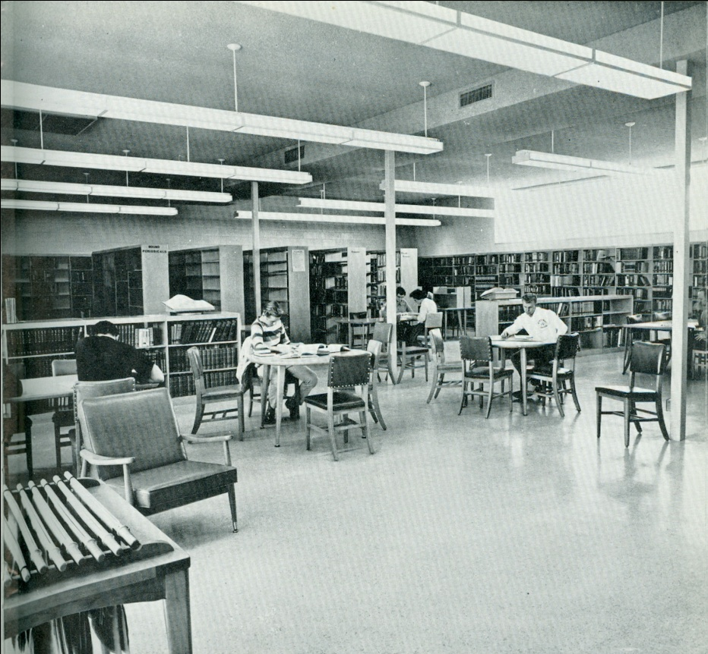
Liberal Arts Building (NPA)
By the 1960s, the college decides that the collection and library merits a separate building of its own. By 1962, the library relocates to the Liberal Arts building which is now Nelson Performing Arts. However, this relocation is short-lived.
“The library has study desks, comfortable chairs for leisure reading, and a microfilm camera which add to the pleasure of studying and reading.”
Trapper Yearbook, 1962
Librarians: H. Dean Hee (‘60-63)
Sandra Tolman (‘62-64)
Alma McKitrick (‘63-66)
Technical Assistants: Angela Garrett (‘62-68)
Joan Leeper (‘64-93)

Slide 6
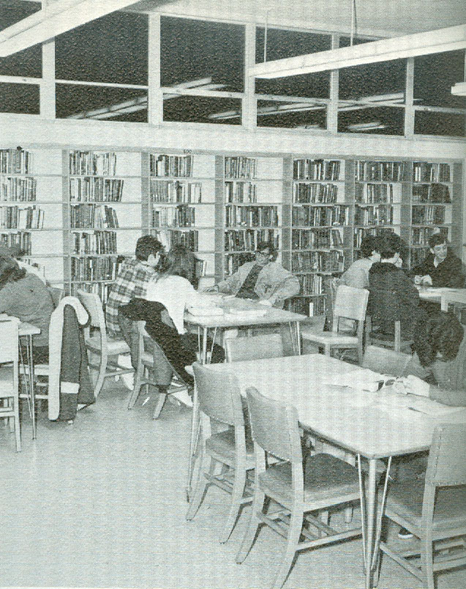
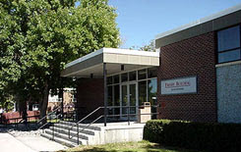
The Frisby Era
The more permanent Frisby Library, located in the current Frisby building (upstairs, then basement), opens in 1966. Funds are short to keep the building open during the evening hours, so faculty members take turns as the “evening librarian.”
Frisby Library, Trapper Yearbook, 1968
Librarians: Terry Thompson (‘66-68)
John Roland (‘68-91)
Technical Assistants: Angela Garrett (‘62-68)
Joan Leeper (‘64-93)
Rosabelle Mahoney (‘66-74)
Vera Mae Hand (‘68-74)
Joyce Daugherty (‘74-80)
Ruth Hillman (‘74-77)
Velma Maddox (‘77-80)
Nelloyd Tharp (‘80-83)
Elfriede Milburn (‘80-97)

Slide 7
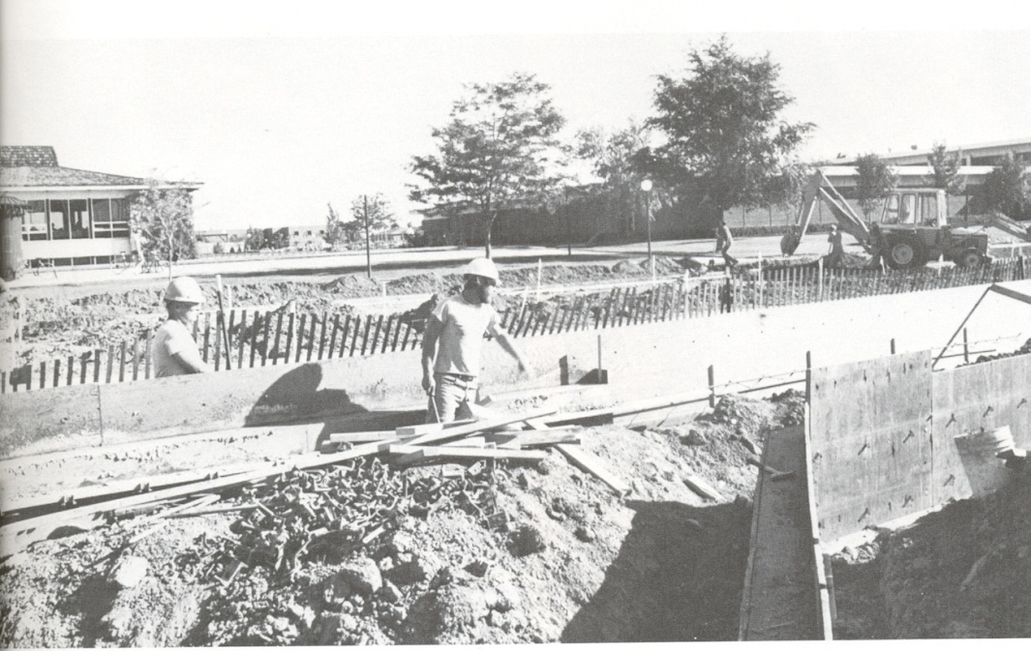
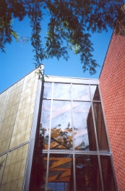
John Taggart Hinckley Library
By the 1980s, with larger library collections, and greater need for technology and expanding specialized service, the library outgrows its space. In the spring of 1983, the 21,000 square foot John Taggart Hinckley Library, housing a collection of 39,000 volumes, opens for use by residents of the Big Horn Basin.
Laying the foundation, circa 1982, Hinckley Library Archives

Slide 8
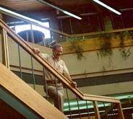
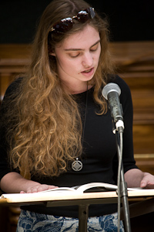
The new Hinckley Library includes an electronic security system, a seminar classroom, foreign language listening labs, an art display, reading area, computer/typing rooms and an amphitheater for small group performances, lectures, and poetry readings.
John Roland, Library Director (1968-1991),
photography collection, John T. Hinckley, 1983

Slide 9
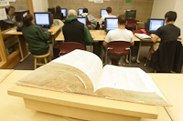
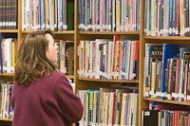
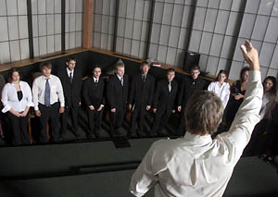
The new building is designed for the future and by 1987, it contains a computer lab for student use.
Then, in 1990 Northwest College joins CARL,
the Colorado Alliance of Research Libraries.
For the first time, library holdings, as well as the
holdings of 75 other college, university, and public
libraries, are available via computer.
Six computer terminals in the library building,
allow students, faculty, and staff to search
library collections all over the Rocky Mountain
region. Hinckley Library is the first
community college in Wyoming
to become a full member
of the CARL
consortium.
Librarian/Director: Jerome Halpin (‘91-96)
Technical Assistants: Deb Kelly (‘83-88; 97- present)
Diane Martin (‘88- present)
Rita Wenzel (‘93-94)
Jan Hanna (‘94-97)
Deb Ross (‘95-?)

Slide 10
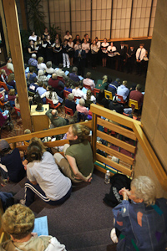
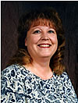
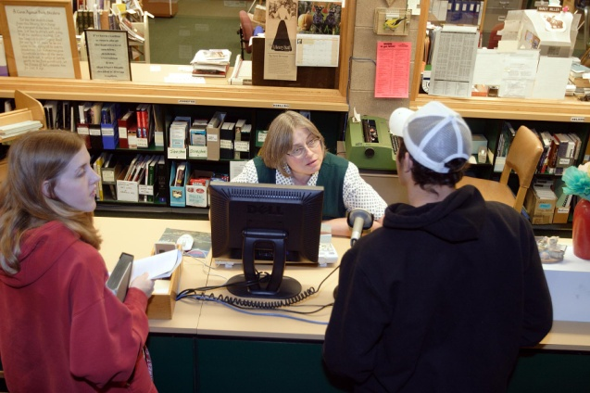
In 1997, Hinckley Library leaves CARL and joins the Wyoming Libraries Database (WYLD), a consortium of ninety public and academic libraries in Wyoming. This consortium allows the users of Hinckley Library access to local, state, nation, and world paper and electronic resources, via a thriving network of libraries.
Librarian/Director: Kay Carlson (‘96-2005)
Librarian: Diane Martin (‘88-present)
Technical Assistants:
Deb Kelly (‘83-88; 97- present)
Nancy Miller (‘97-present)
Evening/Weekend Assistants:
Garnet Schatz (‘97-2005)
Terri Timmons (‘97-2000)
David Bingham (2000-2001)
Patti Thompson (2001-2003)
Volunteers:
Virginia Johnson
Sara Cubbage
Edna Caslick

Slide 11
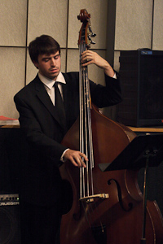
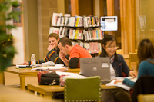
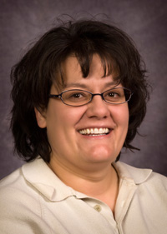
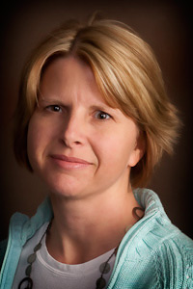
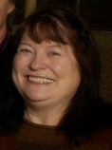
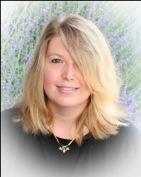
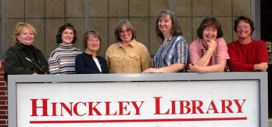
Years Leading up to the New Renovation
Over the next decade, Northwest College continues to grow in student numbers and student programs. Student demand for increased resources, computer space, and study rooms places the library on the “wish list” for increasing its size. Wireless technology and laptops for checkout are provided. Library instruction skyrockets! At times all seats, rooms and computers in the library are occupied causing potential turn-a-ways.
Librarian/Director:
Susan Richards(2005-present)
Evening/Weekend Supervisors:
Diane Glass (2003-2008)
Anna Cubbage (2005-2008)
Katie Fross (2005-2006)
Marilyn Drew (2006-present)
Sandi Fisher (2008-2009
Katie Griffin (2008-2009)
Ardith Story (2009-2009)
Librarians:
Deb Kelly (‘83-88; 97- present)
Diane Martin (‘88- present)
Nancy Miller (‘97-present)
Facilities Assistants:
Diane Meidinger
Kara Miller Warren
Volunteer:
Edna Caslick

Slide 12
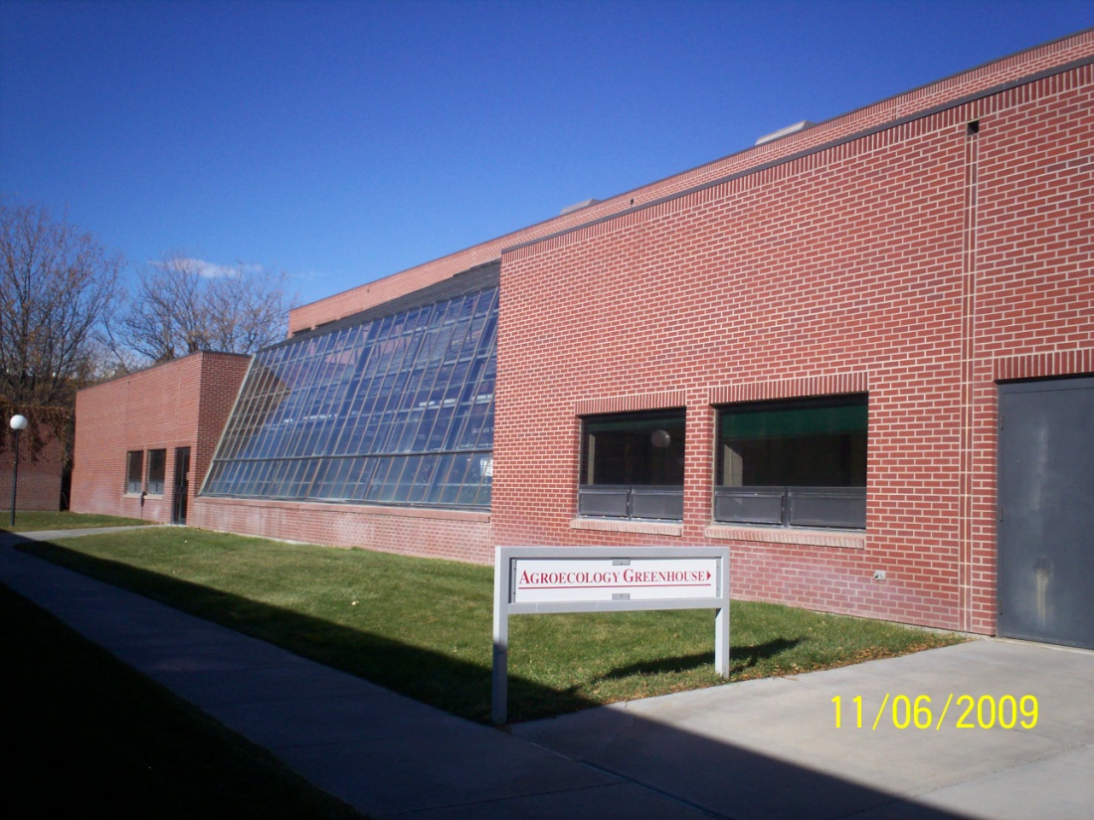
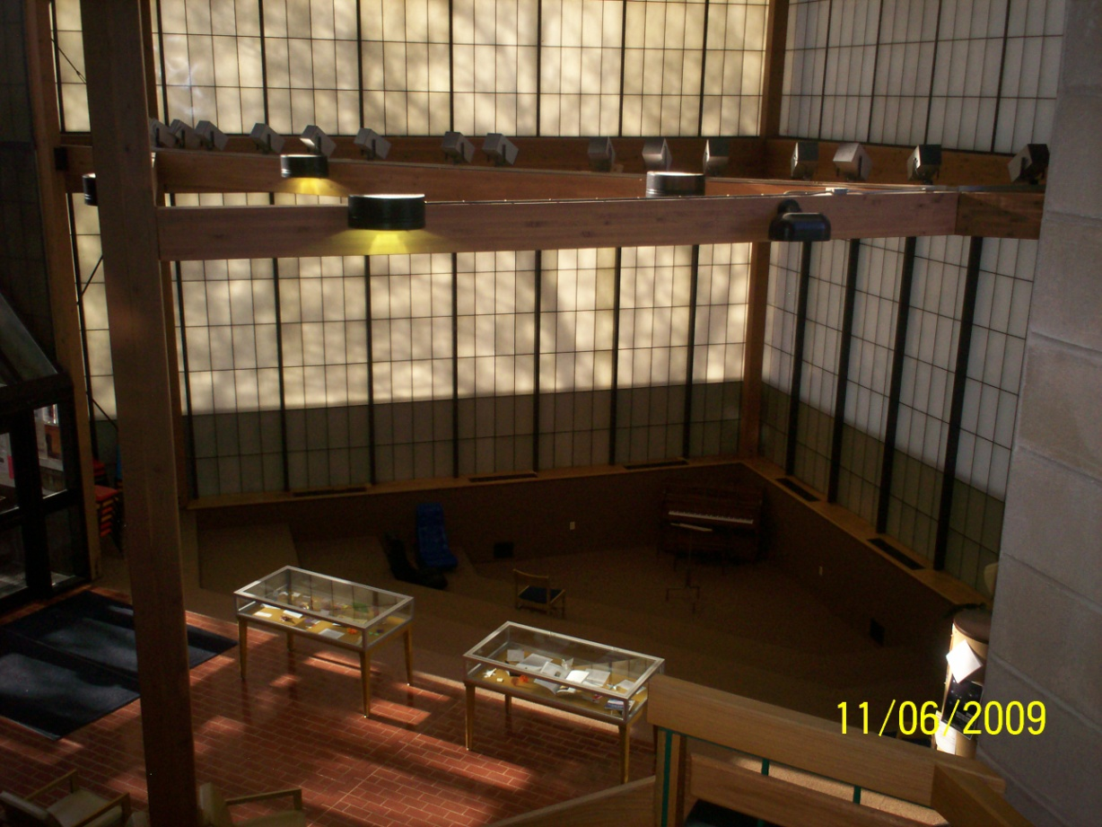
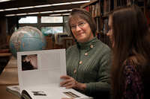
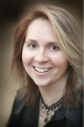
The Library Renovation Begins!
The stars are aligned and there is a fair breeze from the West~ the money gods have spoken. The library addition is a go!
“Knowledge is free at the library.
Just bring your own container.”
~ unknown
Vacated Greenhouse makes room for
Late Night Study & second floor stacks & lounges
Translucent fiberglass panels (Kalwall)
in amphitheater are energy inefficient &
have leaked over the years.
Librarian:
Susan Richards(2005-pres.)
Librarians:
Deb Kelly (‘83-88; 97- present)
Diane Martin (‘88- present)
Nancy Miller (‘97-present)
Evening/Weekend Supervisors:
Marilyn Drew (2006-present)
Rebecca Voss (2010-present)
Tutoring Supervisor:
Carol Zawacki
Writing Coordinator:
Renee Dechert
Facilities Assistants:
Sue Vaught (2008-2010)
Bonnie Muecke (2010-present)

Slide 13
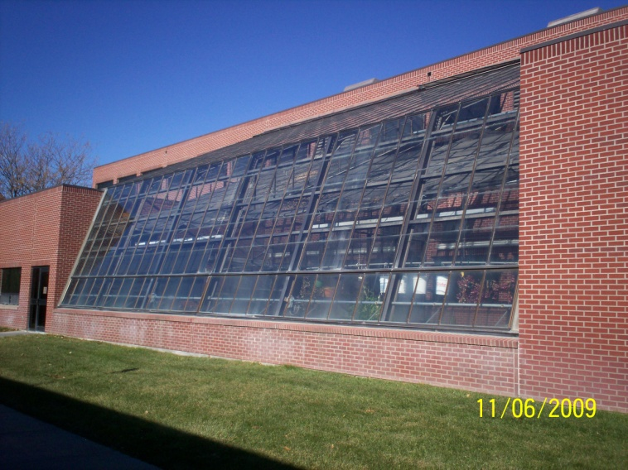
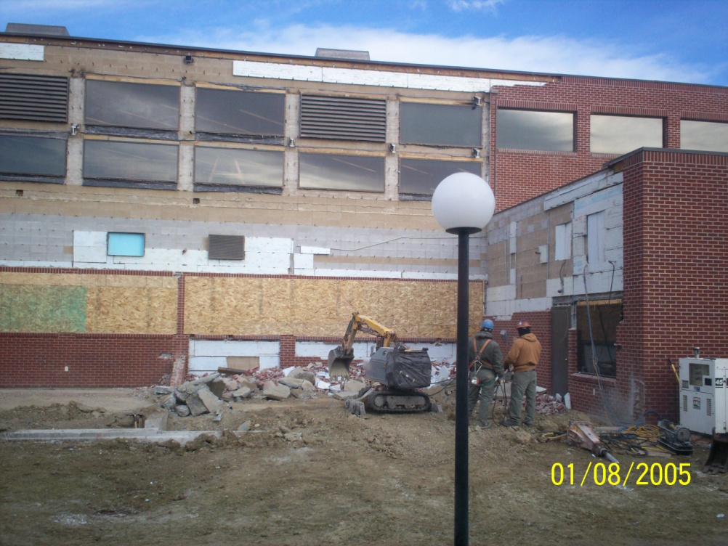
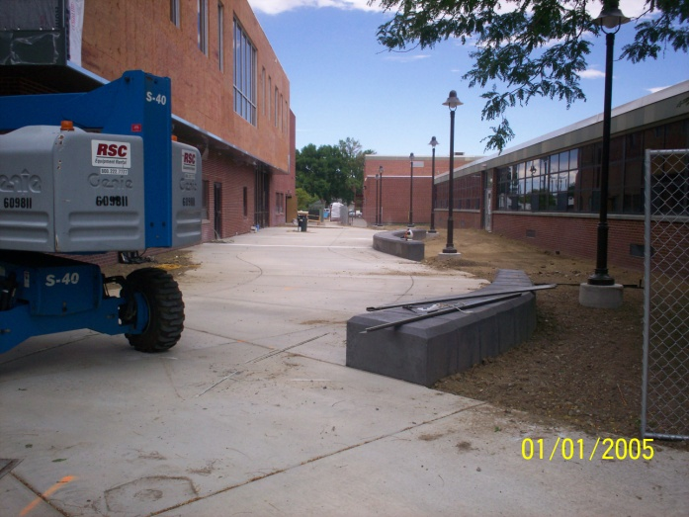
$2.167 million is appropriated from NWC budget reserves and State of Wyoming Major Maintenance funds. The library expands by 5316 square feet and adds group study areas, a classroom/open lab, a late night study area, additional computers and technology infrastructure, efficient staff workspaces, and tutoring & writing services.
Construction begins in December 2009~ the temperatures drop & the snow arrives. Construction workers are allowed to work 45 minutes before a break to re-warm hands & body are required.
Old greenhouse
Greenhouse removal
New breezeway, upstairs lounge & Late Night Study

Slide 14
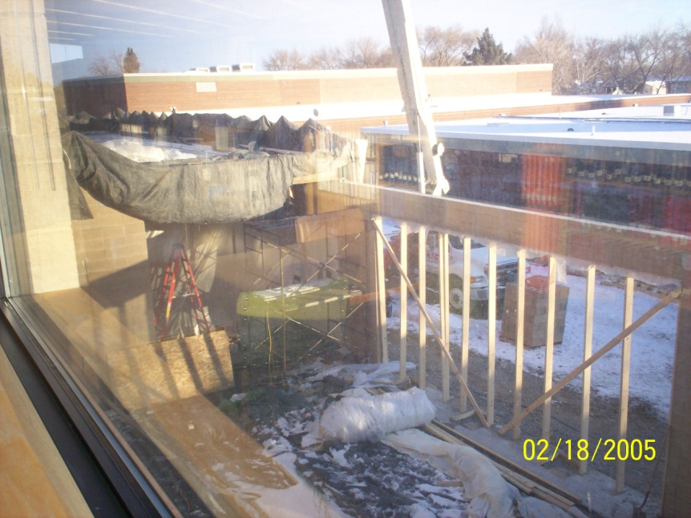
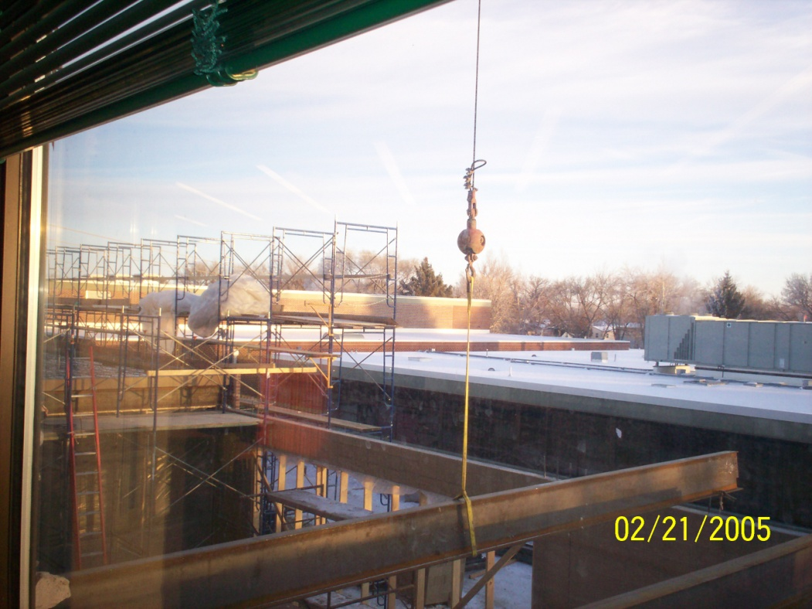
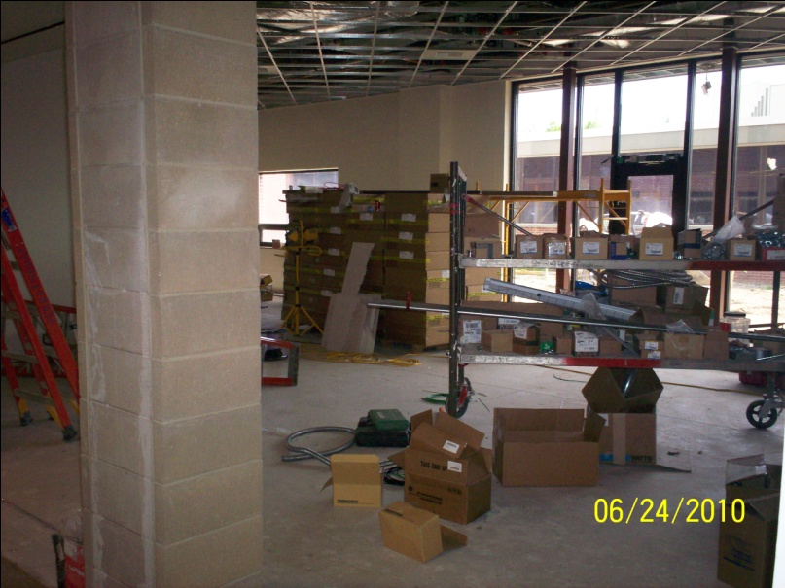
Late Night Study Area
Old greenhouse area
Swinging beams ever so gently
The LNS is open 5 days
per week until 2 a.m.
Finishing work & electrical

Slide 15
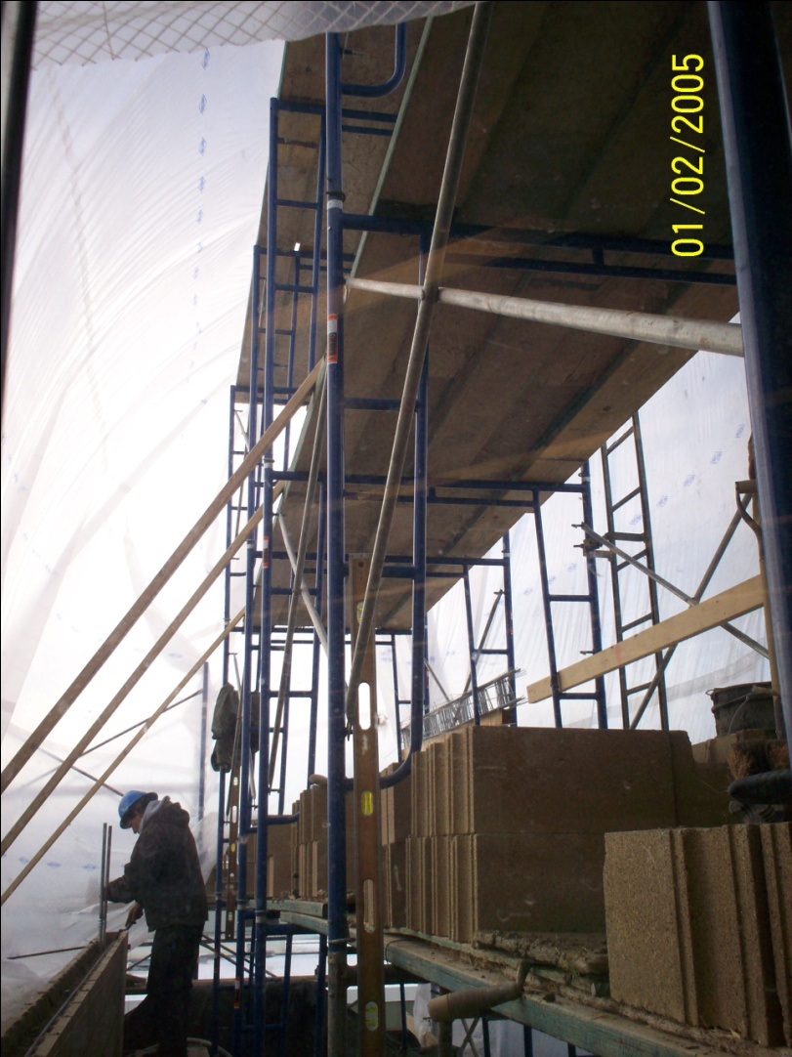
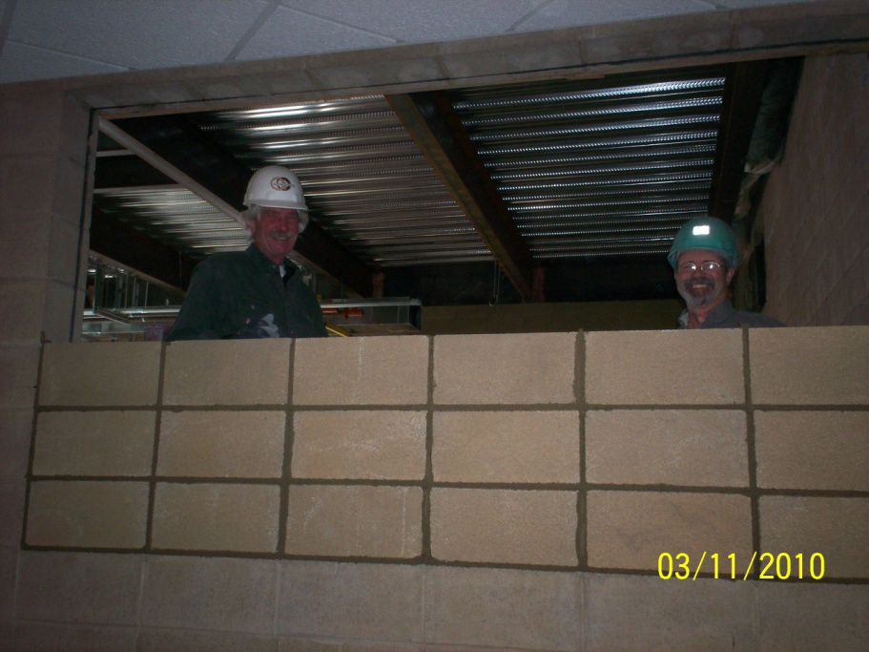
Second floor & walls go up in subzero temperatures
Pouring
the second
floor
New wall between tutoring offices
and second floor book stacks
Enclosing a greenhouse window

Slide 16
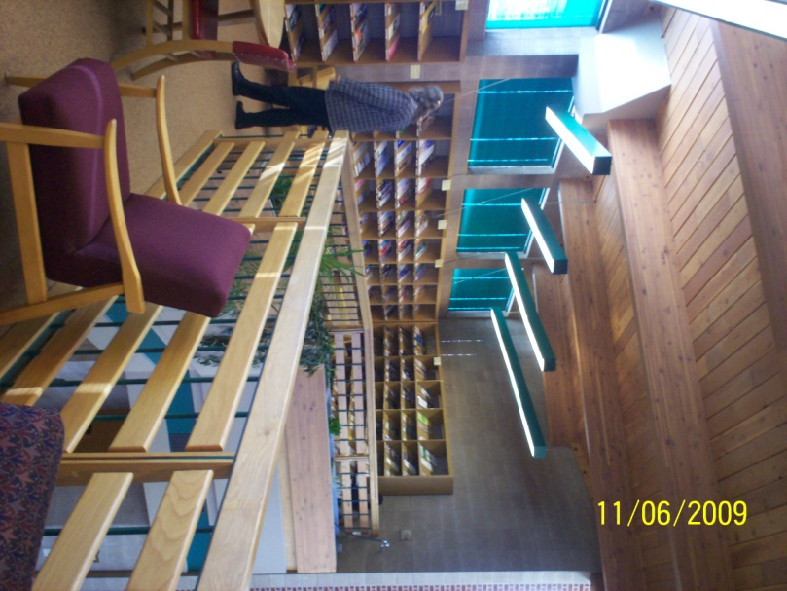
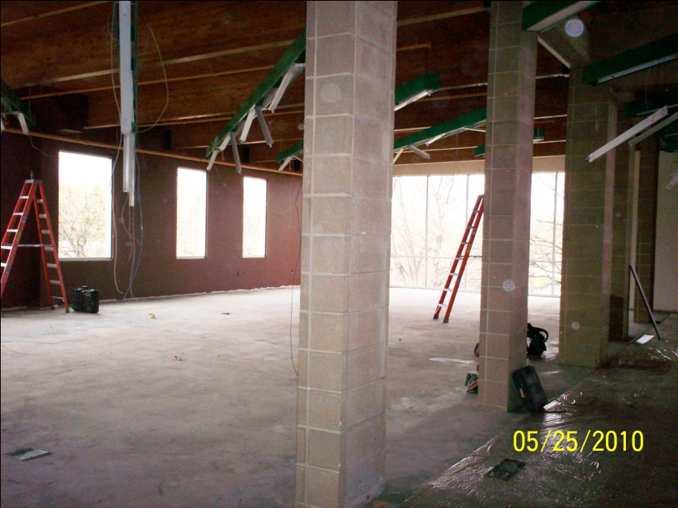
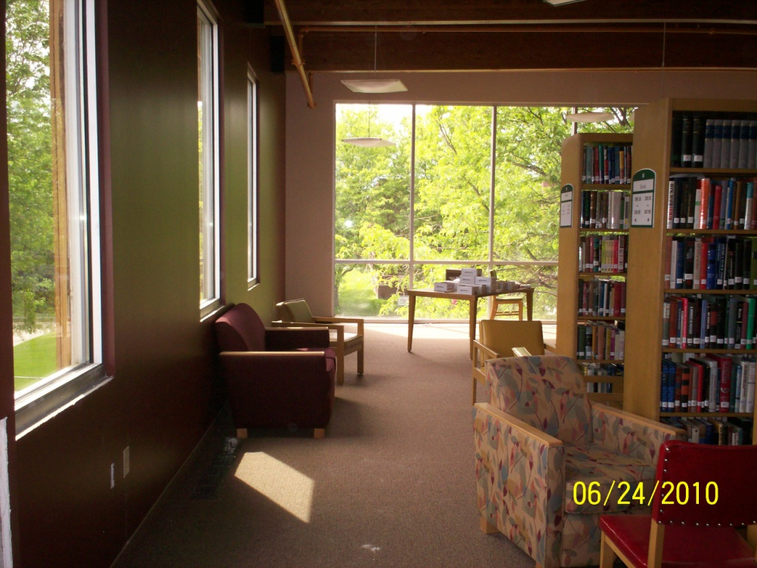
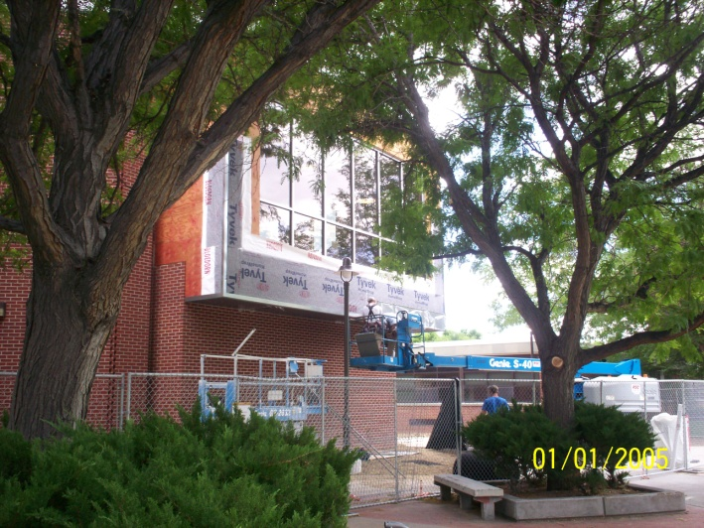
New west end lounge & book stacks
Pillars are location of “original
south wall & windows”
Original south wall with windows
West lounge window
Upstairs book stacks looking west

Slide 17
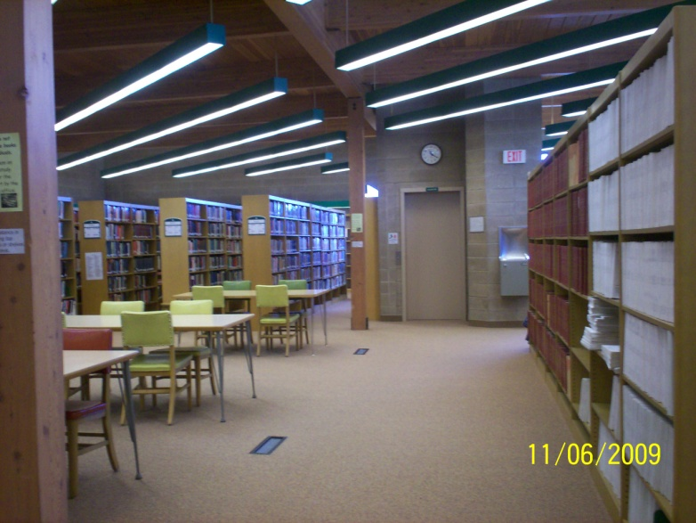
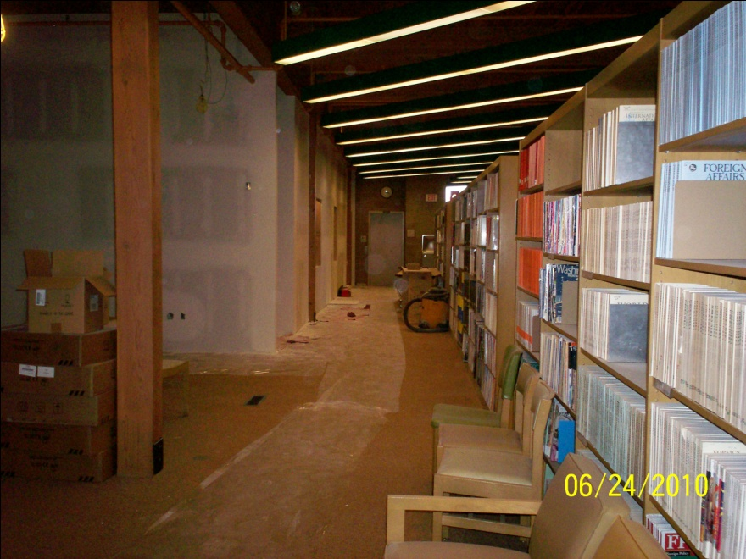
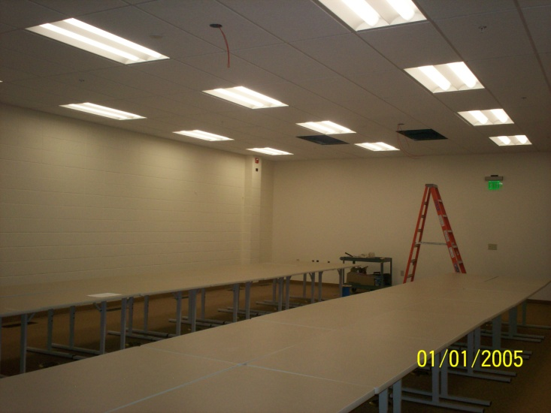
New Classroom/Open Lab
Book stacks, elevator, and periodicals on right
New classroom/lab, elevator, and periodicals on right
The library provides 58 PCs , 6 MACs
& 5 laptops for student use—wireless
access is available.
Wiring the 30-computer classroom/open lab

Slide 18
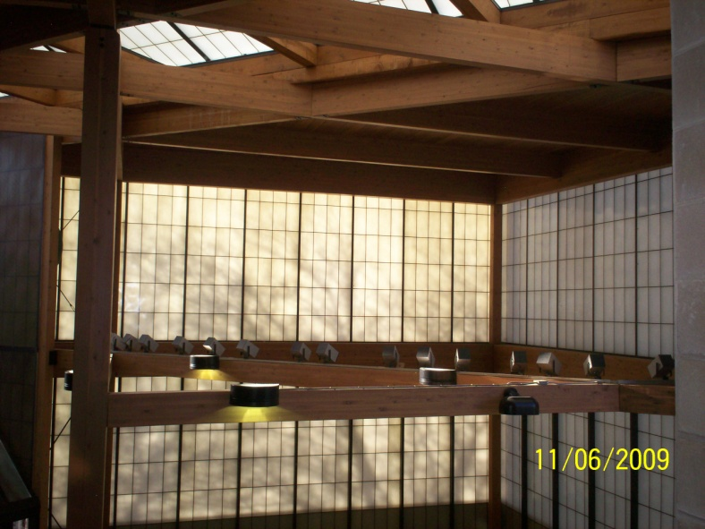
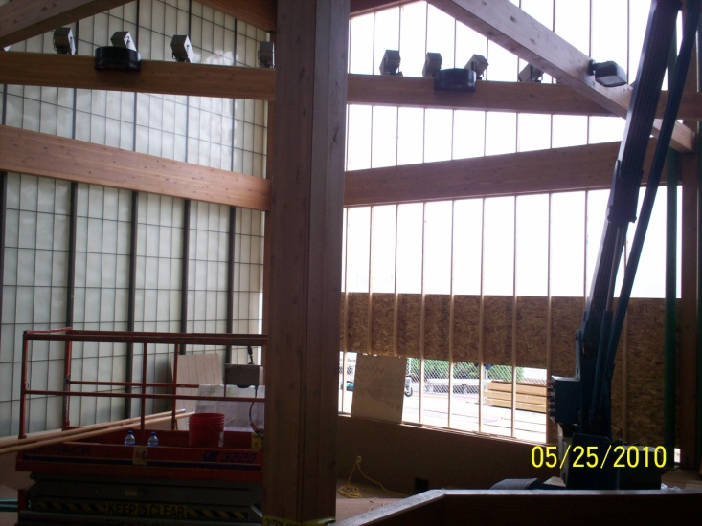
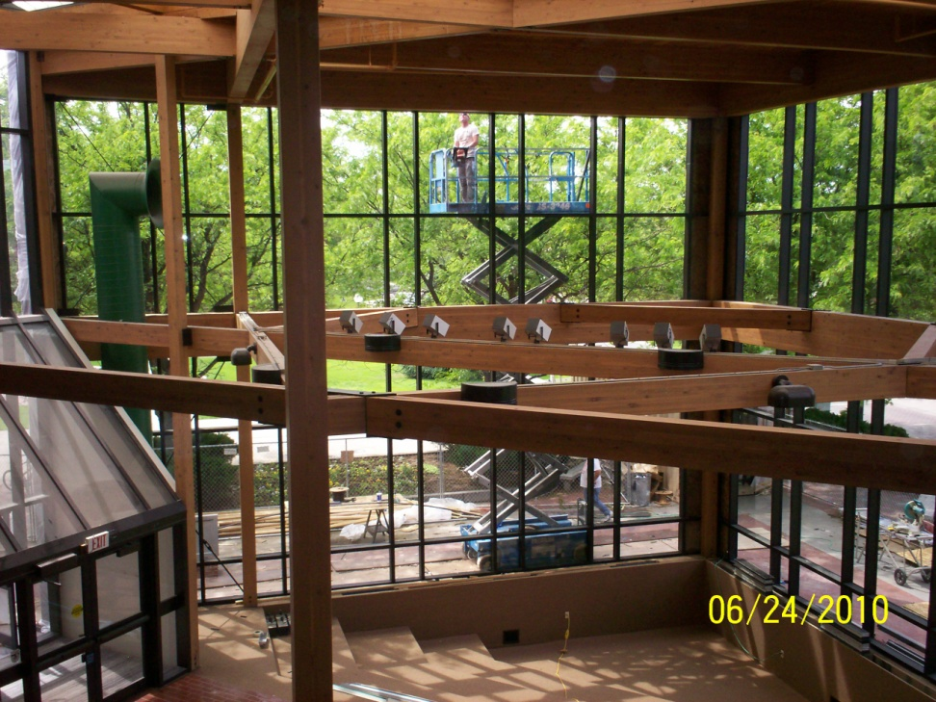
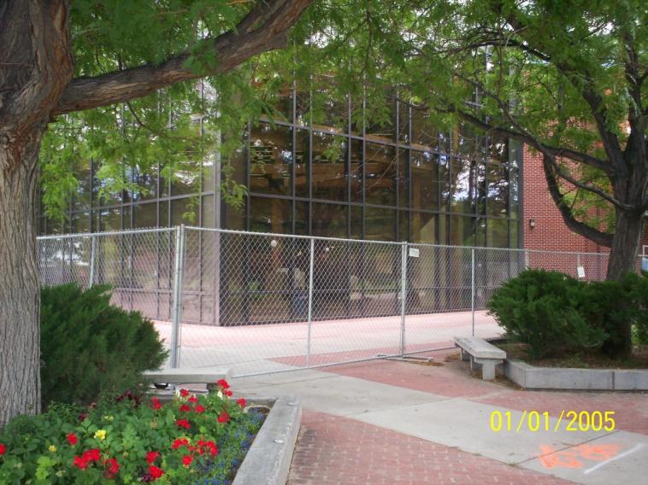
“Wow! Since last week, we have been able to see the
outside world, including the weather, from our
circulation desk. This is something that has never
happened in this library.” ~ Susan Richards, Library Director
The Amphitheater—A facelift!

Slide 19
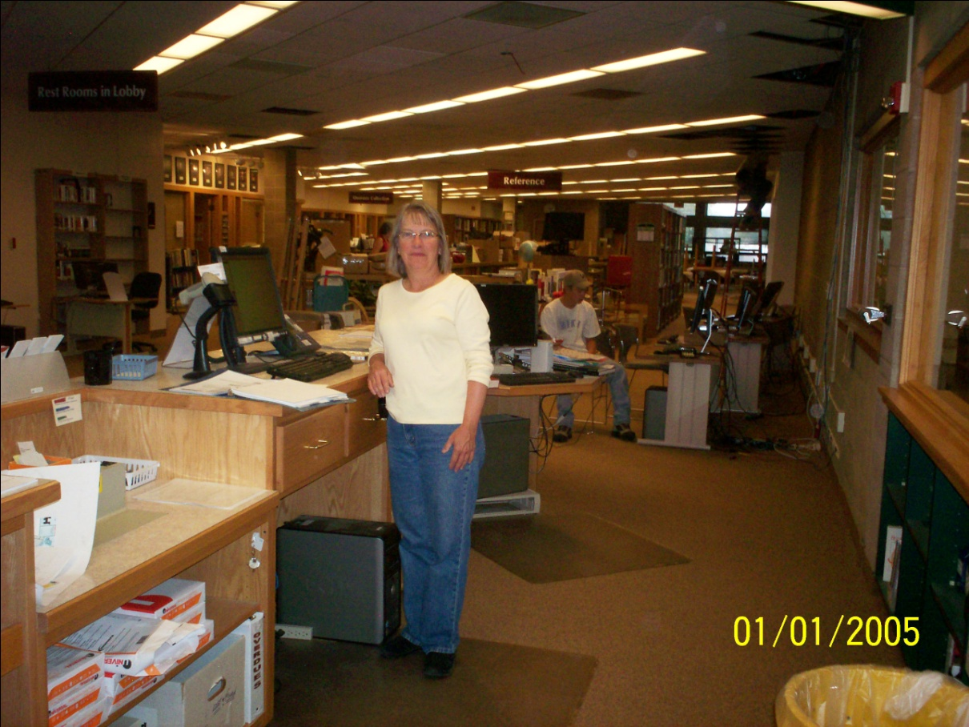
Other memorable moments~
“Welcome to the library,
don’t mind the legs hanging
out of the ceiling!”
Structured Chaos—thankfully this
was not during summer session.
Upstairs lounge over
Late Night Study
Original & future staff work area
Bill the buffalo found a more regal & dignified
existence in the Science & Math building

Slide 20
New Late Night Study
wall—balmy in the
tent during sub-zero
temperatures
Future Tutoring/Writing Services
Removing brick from facing—
decibel levels are off the chart!
This was NOT in my contract!

Slide 21
Thank you for sharing our history!
We wish to thank the NWC Administration, Physical Plant & Computer Services, Wyoming taxpayers, Groathouse Construction, and the many Wyoming sub-contractors and workers who spent the past 10 months with us. The inconvenience and sometimes frustrating moments have been worth it. We now have a Great library!
“A library is not a luxury but one of the necessities of life.”
~Henry Ward Beecher

